Slide 1

Green Pace
Security Policy Presentation
Developer: Tyler Hollingsworth

Slide 2

OVERVIEW: DEFENSE IN DEPTH
Our security policy is based on the defense in depth practice which is illustrated below
This is to ensure that there are multiple layers of overlapping security measures in place
By doing this we ensure that there are no overlapping holes or vulnerabilities in the system to which an attacker could exploit.

Slide 3
THREATS MATRIX
Secure coding standards always come with a range of risks.
these threats will need to be handled according to the risk involved.
This illustration shows how the security policy standards can be grouped into a threat matrix.
The threat matrix then determines the risk to the system.
We can also use tools to automate checks which will find non-compliant code.
Likely A threat is more likely to occur [STD-002-CPP] [STD-003-CPP] [STD-004-CLG] [STD-005-CLG] [STD-007-CPP] [STD-010-CPP] | Priority Risk is severe or likely [STD-004-CLG] [STD-005-CLG] [STD-006-CLG] [STD-007-CPP]
Low priority Risk is not as severe or likely [STD-001-CPP] [STD-002-CPP] [STD-003-CPP] [STD-008-CPP] [STD-009-CPP] [STD-010-CPP] | Unlikely A threat is less likely to occur [STD-001-CPP] [STD-006-CLG] [STD-008-CPP] [STD-009-CPP]

Slide 4
10 PRINCIPLES
Validate Input Data
[STD-001-CPP]
Heed Compiler Warnings
Architect and Design for Security Policies
Keep It Simple
Default Deny
Adhere to the Principle of Least Privilege
Sanitize Data Sent to Other Systems
[STD-004-CLG]
Practice Defense in Depth
[STD-007-CPP]
Use Effective Quality Assurance Techniques
[STD-006-CLG]
[STD-007-CPP]
Adopt a Secure Coding Standard
[STD-001-CPP]
[STD-002-CPP]
[STD-003-CPP]
[STD-005-CLG]
[STD-007-CPP]
[STD-008-CPP]
[STD-009-CPP]
[STD-010-CPP]

Slide 5
CODING STANDARDS
[STD-007-CPP] - Guarantee exception safety
[STD-004-CLG] - Sanitize data passed to complex subsystems
[STD-005-CLG] - Do not access freed memory
[STD-002-CPP] - Use valid references, pointers, and iterators to reference elements of a container
[STD-003-CPP] - Use valid references, pointers, and iterators to reference elements of a basic_string
[STD-010-CPP] - Prefer special member functions and overloaded operators to C Standard Library functions
[STD-001-CPP] - Pass an object of the correct type to va_start
[STD-008-CPP] - Do not cast to an out-of-range enumeration value
[STD-009-CPP] - Close files when they are no longer needed
[STD-006-CLG] - Use a static assertion to test the value of a constant expression

Slide 6
ENCRYPTION POLICIES
Encryption at rest - Encryption at rest is the practice of encrypting stored data such as that held within a server. By encrypting stored data, it is protected from both attackers who gain unauthorized access to the servers and from the system administrators being able to read the raw data.
Encryption in flight - Encryption in flight is the practice of encrypting all the data that is being transferred. This protects the data from being intercepted and read by a man in the middle attack.
Encryption in use - Encryption in use is the practice ensuring data is never left unsecured regardless of stage or location. This protects all the data of the system from attackers and their exploits no matter if the data is being used, stored, or transferred.

Slide 7
TRIPLE-A POLICIES
Authentication - This is the practice of verifying a user is who they say they are through login methods such as using a user id and password or through 2-step verification.
Authorization – This is the practice of using deny by default and least privilege access for all the system users. This means that all the new users added to the system will start with no access to any resources of the system and an administrator will then give them access to only the minimal resources that the user will need to be able to complete their tasks.
Accounting – This is the process of logging users' session statistics and usage information so that all system resource accesses and changes are carefully monitored.

Slide 8
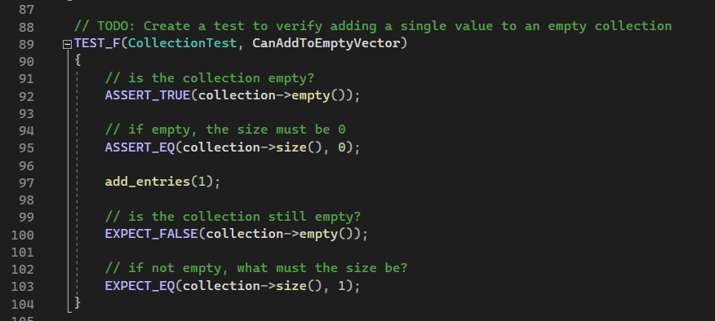
Unit Testing: Can add to empty vector

Slide 9
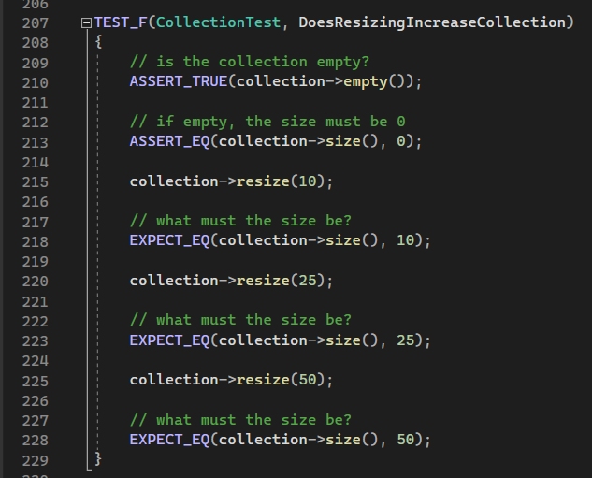
Unit Testing: Does resizing increase collection

Slide 10
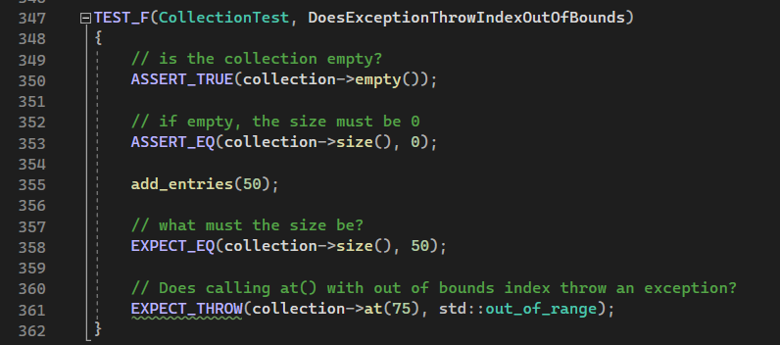
Unit Testing: Does exception throw index out of bounds

Slide 11
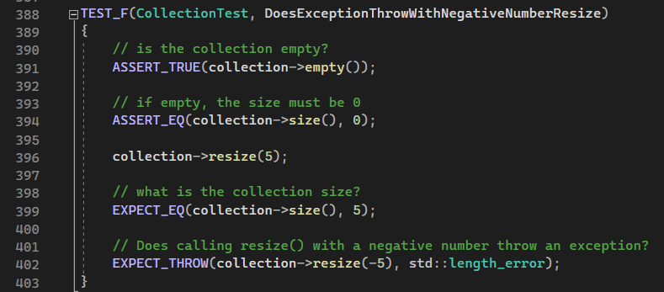
Unit Testing: Does exception throw with negative number resize

Slide 12

AUTOMATION SUMMARY

Slide 13
TOOLS
Some tools that can be used to help ensure that the policy is implemented in the DevSecOps pipeline are:
Clang
CodeSonar
Parasoft c/c++ test
Polyspace Bug Finder
Astree, Helix QAC
Coverity
LDRA tool suite
Axivion Bauhaus suite
Eclaire
and RuleChecker

Slide 14
RISKS AND BENEFITS
The risks of waiting to implement security into a project is that it is exponentially more difficult to correct when a problem is eventually found. Sometimes this results in a complete rework of the code that goes into the system
The benefit of not leaving security until the end means that the system will be more secure, have less vulnerabilities, and errors will be caught sooner.

Slide 15
RECOMMENDATIONS
Always communicate with stakeholders in an effective, efficient, and transparent manner.
Always have a support network available for second opinions and to answer any questions
If you are unsure of a requirement, always ask probing questions to get more details and clarification
Have a plan when exploits do occur and an action team to address the exploit
Never cut corners for any reason

Slide 16
CONCLUSIONS
It is highly important to adopt and adhere to a company security policy so that everyone is on the same page
Pay particular attention to the ten principles and coding standards set forth by your company
Identify threats to the system and then rank them in order from the most critical to the least critical
Always use defense in depth, encryption, and Triple-A practices in your code
Use unit tests to automate and verify that the code you write behaves appropriately
Always follow the SecDevOps pipeline to integrate security into the development lifecycle
Lastly adhere to the tools that the company has approved for use

